Slide 1
Ant Algorithm

Slide 3
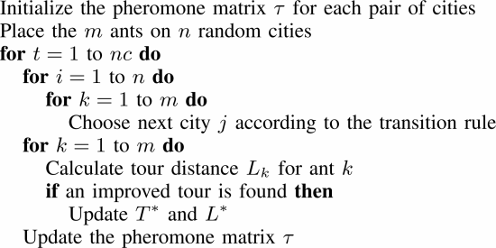

Slide 4
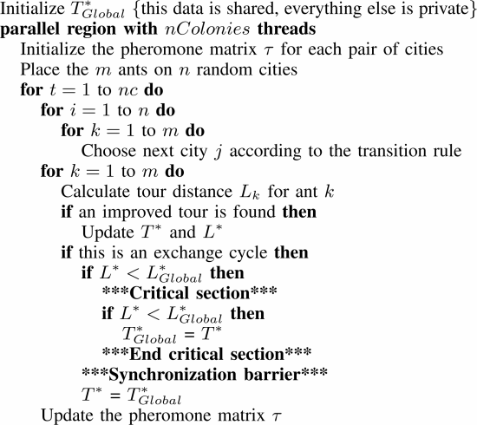

Slide 8
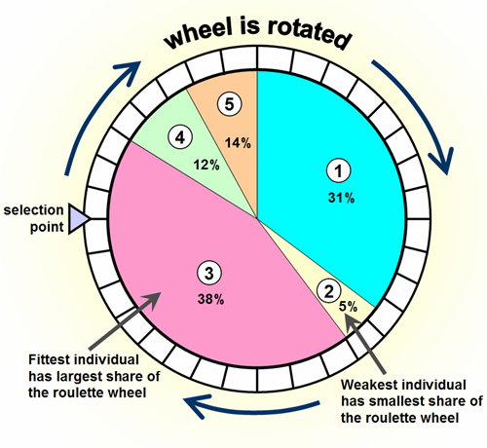

Roulette Wheel Selection

Slide 9
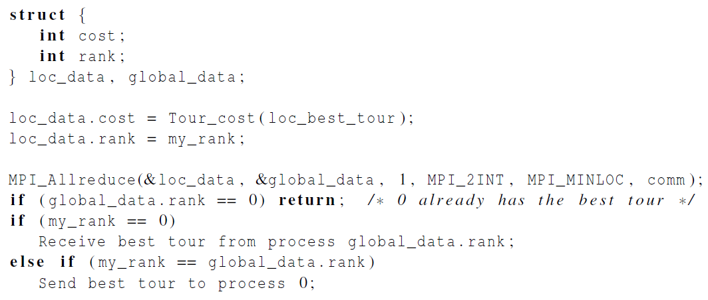

Printing the best tour

Slide 10
Homework 6
使用MPI+OpenMP實作，每一台電腦各啟動一個process，每個process再fork出multi-thread

